Slide 1
SAGA DESIGN Pattern: Orchestration
BY
B. NIHAL VARMA

Slide 2
INTRODUCTION
A Saga is a design pattern used in microservices architectures to manage distributed transactions, ensuring data consistency across multiple services.
It breaks down a large transaction into a sequence of smaller, independent transactions, each performed by a different service.
If any step fails, compensating transactions are executed to undo the preceding operations, thus maintaining system consistency.

Slide 3
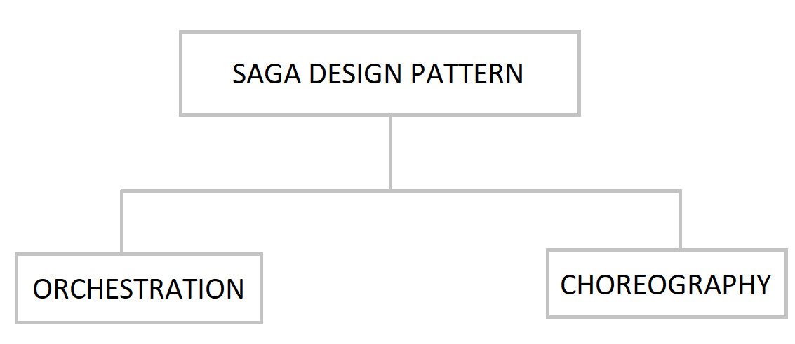
Types of Saga Patterns
There are two approaches for Saga design Patterns:
Orchestration
Choreography

Slide 4
ORCHESTRATION APPROACH
Orchestration in microservices helps in coordination and management of multiple services to automate and streamline complex workflows or business processes
In an orchestration model, a centralized orchestrator service directs and controls the execution of tasks by instructing each service on what to do and when to do it, ensuring that the overall process is completed efficiently.
This centralized control makes it easier to manage complex dependencies, error handling, and compensations in distributed systems.

Slide 5
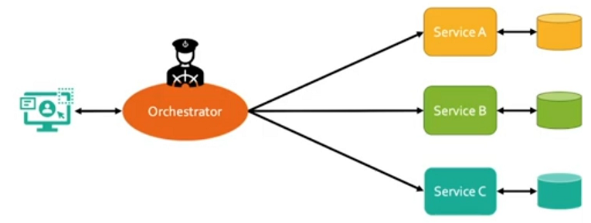
HOW ORCHESTRATOR WORKS?
User sends a Request to the centralized managing service called Orchestrator.
The orchestrator sends commands to each service to execute a transaction.
Each Service performs its local transaction by accessing data from database and sends a success/failure response back to the orchestrator.
If a Transaction fails, the orchestrator initiates compensating transactions to undo the previous actions.

Slide 6
COMPENSATION IN ORCHESTRATION
Compensation is a process of undoing (rollback) or reversing actions taken by previously completed transactions when a subsequent transaction in a sequence fails.
This is especially important in the saga pettern where each step in a distributed transaction is independent
In Orchestration, when one service fails orchestrators gives the command to all previously executed services to undo and rollback the changes.

Slide 7
Examples of Orchestration
E-Commerce Order Management: A user places an order online involving multiple services (inventory, payment, shipping).
The Orchestrator coordinates the entire process, ensuring each services of order management are executed successfully
If any service fails, orchestrator gives command and all other services are rollbacked.
User OTP Management: When User initiates a login, the orchestrator triggers a request to the OTP generation service, which creates the OTP.
Then orchestrator redirects the OTP Delivery Service(via SMS or Mail) to send the generated code to the user.

Slide 8
Advantages
Centralized Control: In Orchestration, Centralized Service helps in making easier to manage and monitor the saga’s flow
Simplified Error Handling: The Orchestrator Handles all the Errors, Making it easier to ensure Consistency.
Flexibility: Easier to implement complex transactional Workflows.

Slide 9
DISADVANTAGES
Single Point of Failure: Orchestrator is the Critical component of this saga design pattern, if it fails then the whole application fails.
Complexity: The Orchestrator needs to handle all the possible failure senarios and compensations
Potential Bottleneck: The applications may be working slowly, because the orchestrator alone need to handle of all the services.

Slide 10
Tools
Popular Orchestration Tools:
Netflix Conductor
Apache Camel
Languages for implementing orchestration:
Java
Python
Node.js

Slide 11
Conclusion
The Saga Design Pattern using orchestration is a powerful approach for managing complex, distributed transactions in microservices architectures. By centralizing control in an orchestrator, it simplifies the coordination of multiple services, ensuring consistency and reliability across the system. However, this approach comes with trade-offs, such as increased complexity in the orchestrator and potential bottlenecks. Understanding these trade-offs is crucial for effectively implementing this pattern in scenarios where maintaining data integrity is critical. Overall, orchestration provides a structured, reliable way to handle distributed workflows, making it an essential tool in modern microservices design.

Slide 12
THANK YOU…

